Slide 1
Parker Lewis Topic: SPHENIX EMCAL & HCAL TowerSlope Method 12/2/24

Slide 2
Towerslope: Intro
The towerslope method is a relative calibration method that is part of sequential stages of calibrating towers.
Towerslope utilizes exponential like energy distributions to get the calibration factors.
The calibrating values needed are the p1’s.

Slide 3
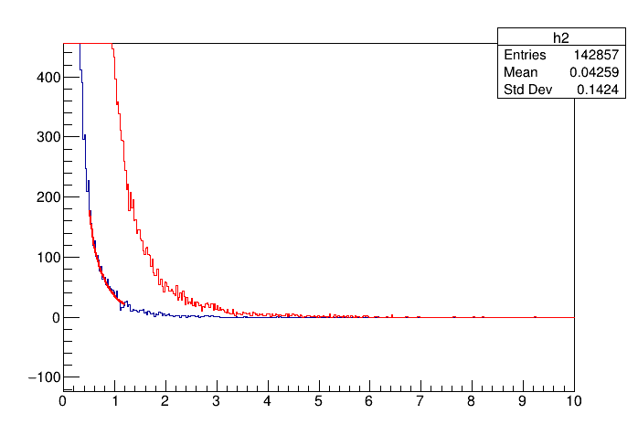
Example Of Method
The method works by first imputing the energy distribution histogram of a tower at one instance od time. (Red Curve)
The blue tower in simulation is an effective distribution at different t, of a tower that needs to be recalibrated.
Recalibration occurs by fitting based on data driven original function on tower adjusted to get calibration factors.

Slide 4
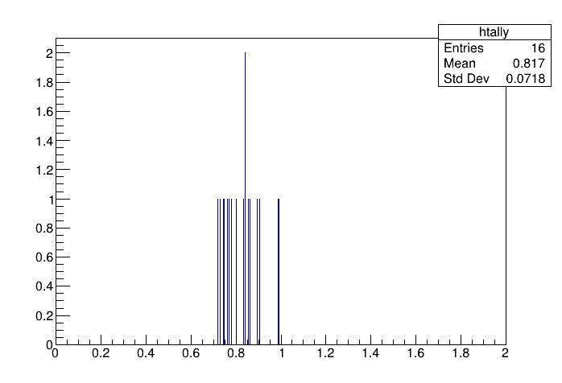
Verification of Method
- A way to do a check if the method works for said tower is to do a division p1_no_shift/P1_shift and see if they get close to shift percentage with precision of data.

Slide 5
What will be in Final Draft
RHIC and SPHENIX slide to give experiment and detector information. (1 slide)
Slide That introduces problem of calibration/Sphenix Calibration overview (1 slide)
Also fix up details in the final presentation.
More example and statistical properties of different ways how to test the towerslope method. (3-4 slides)

